Slide 1
ME5413 Final Project
Group 1
Jia Yansong (A0263119H), Li Jiawei (A0263169X), Deng Chengruyi (A0263158B), and Gao Ziteng (A0263505J)

Slide 2
Content
For ROS Melodic
Task 1 Mapping
Evaluation Metrics
GMapping
Pipeline
Map Result
Evaluation
Cartographer
Pipeline
Map Result
Evaluation
ALOAM
Pipeline
Map Result
Evaluation
Summary
Task 2 Navigation
Pipeline
Move_base
Localization
Planning
Global Planning
Local Planning
Result and Evaluation
Summary

Slide 3
For ROS Melodic
“flir_camera_description” package has no ROS Melodic version.
Comment line 15 and 415 in “/jackal_description/pacakge.xml” and “/jackal_description/urdf/accessories.urdf.xacro” respectively.

Slide 4
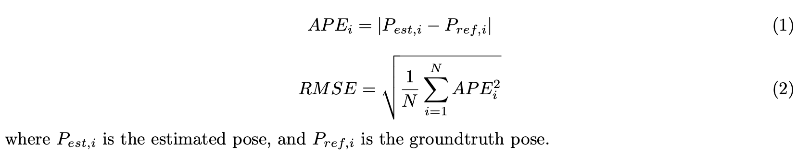
Task 1 Mapping: Evaluation Metrics
The main evaluation metrics for the mapping task are Absolute Pose Error (APE) and Root Mean Square Error (RMSE):

Slide 5
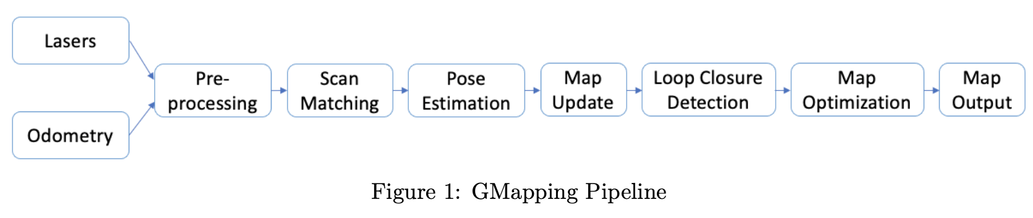
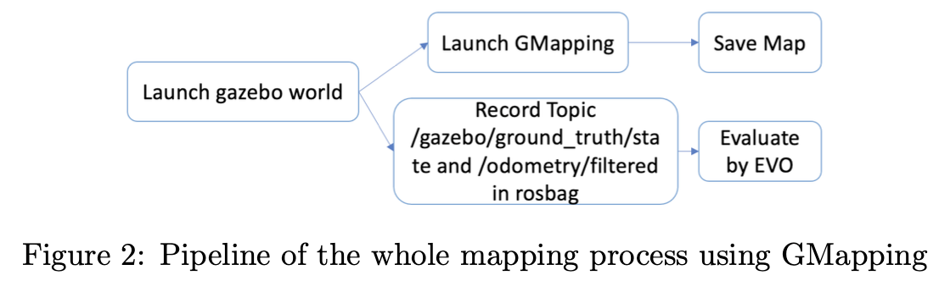
Task 1 Mapping: GMapping: Pipeline

Slide 6
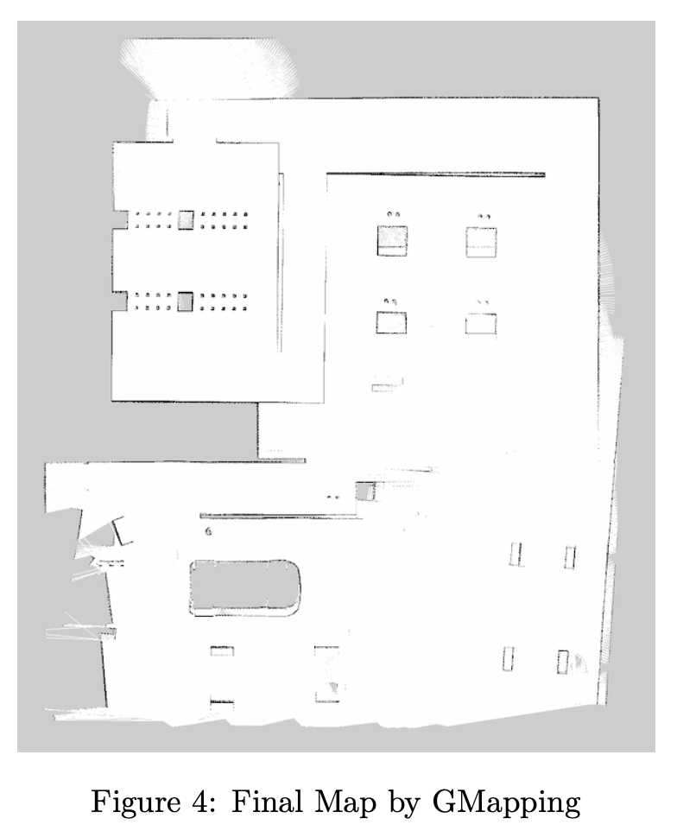
Task 1 Mapping: GMapping: Map Result

Slide 7
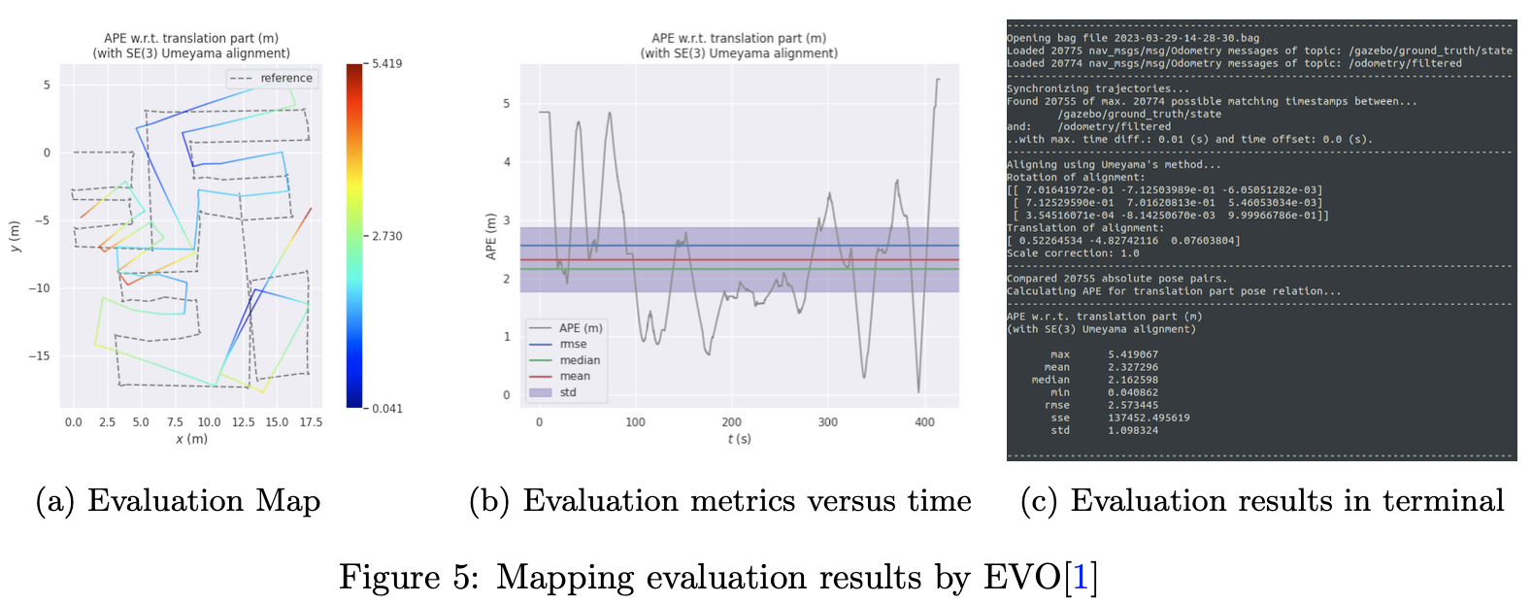
Task 1 Mapping: GMapping: Evaluation

Slide 8
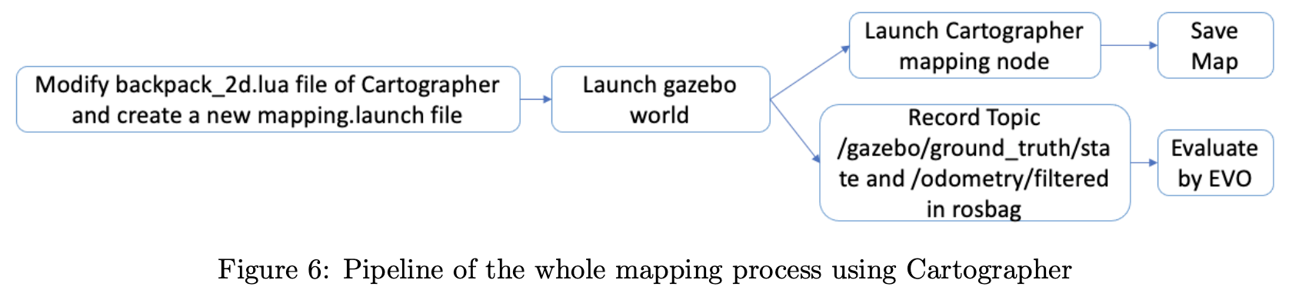
Task 1 Mapping: Cartographer: Pipeline

Slide 9
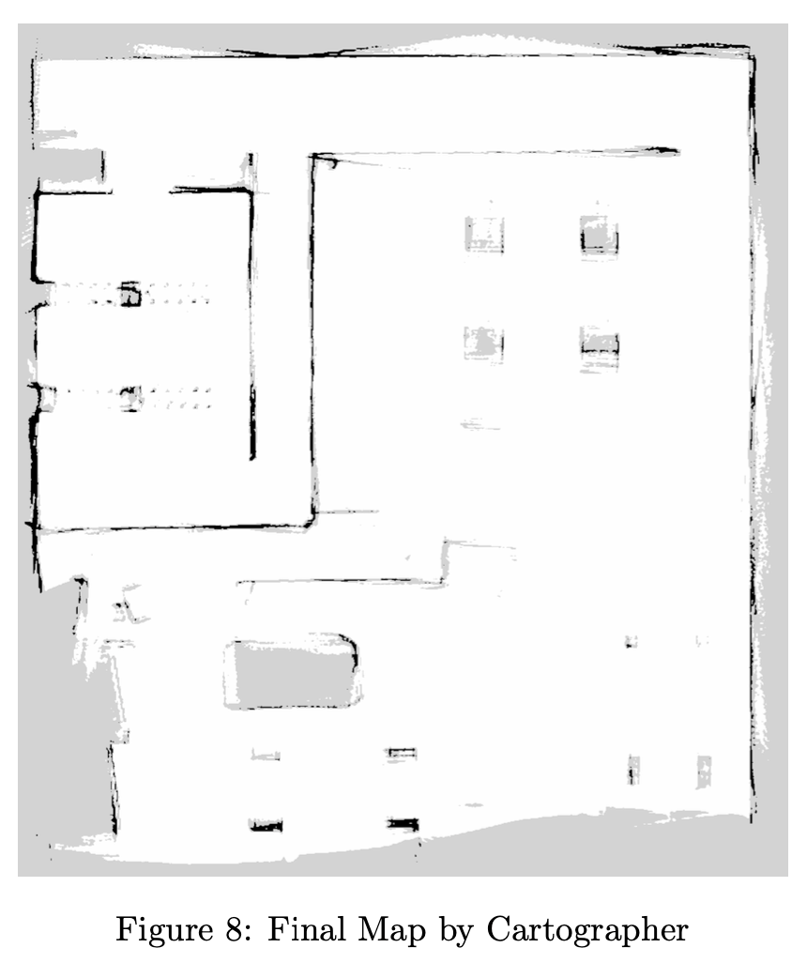
Task 1 Mapping: Cartographer: Map Result

Slide 10
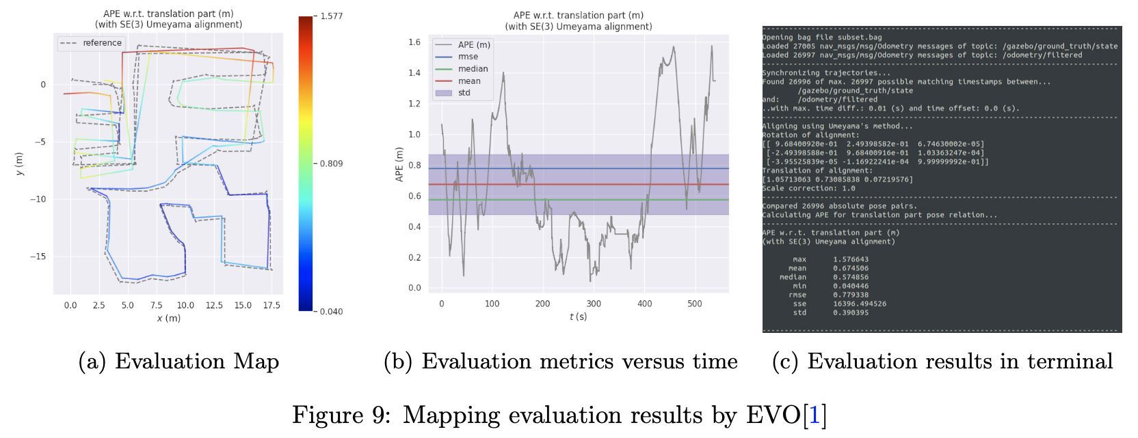
Task 1 Mapping: Cartographer: Evalution

Slide 11
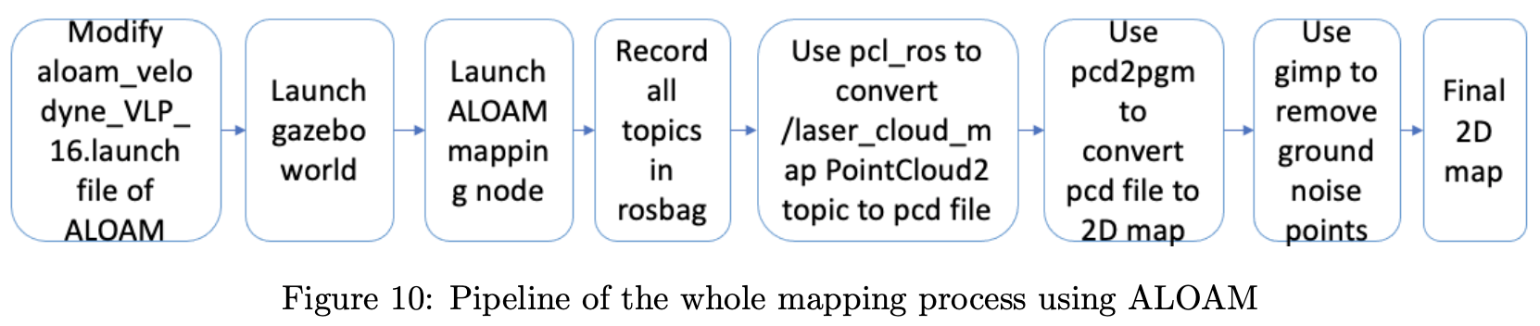

Task 1 Mapping: ALOAM: Pipeline
pcd2pgm: https://github.com/Hinson-A/pcd2pgm_package
GIMP

Slide 12
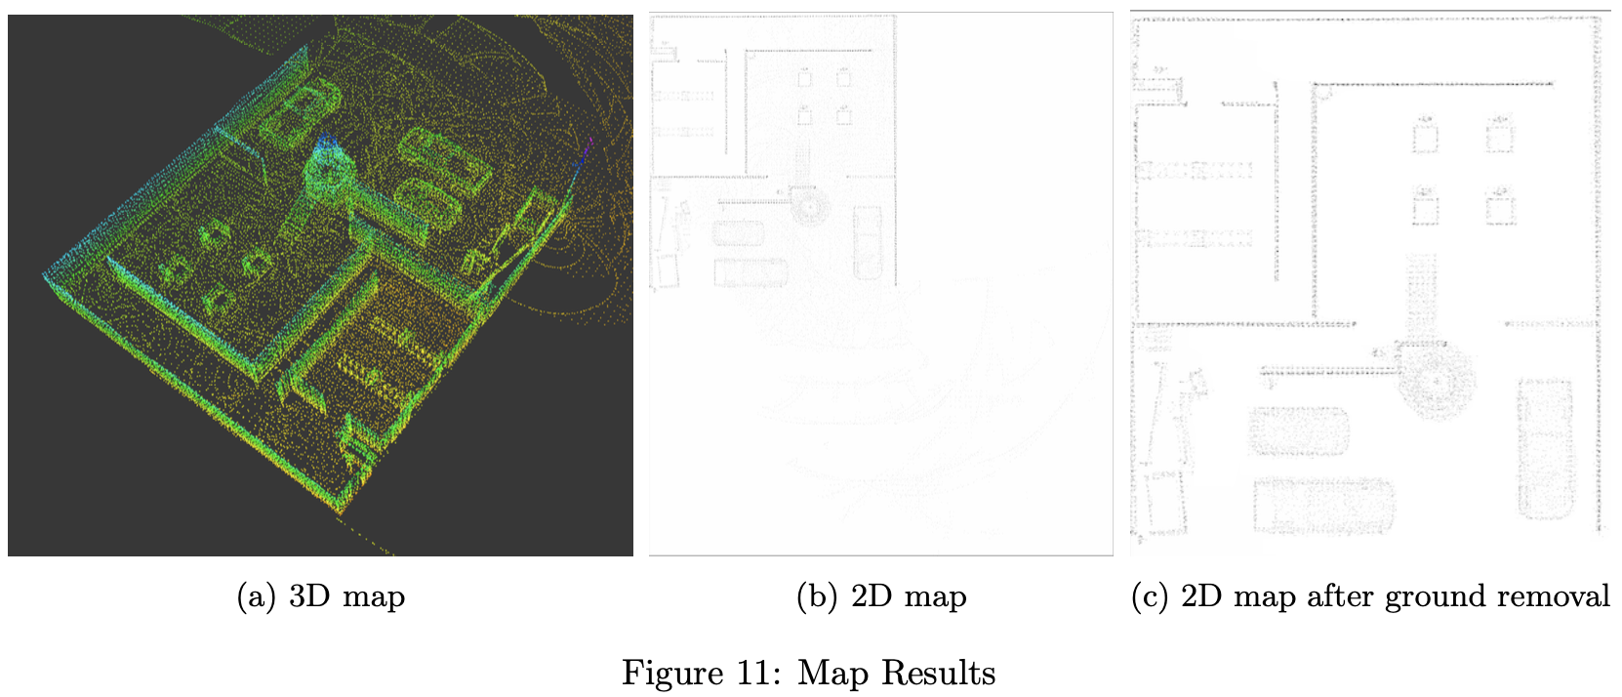
Task 1 Mapping: ALOAM: Map Result

Slide 13
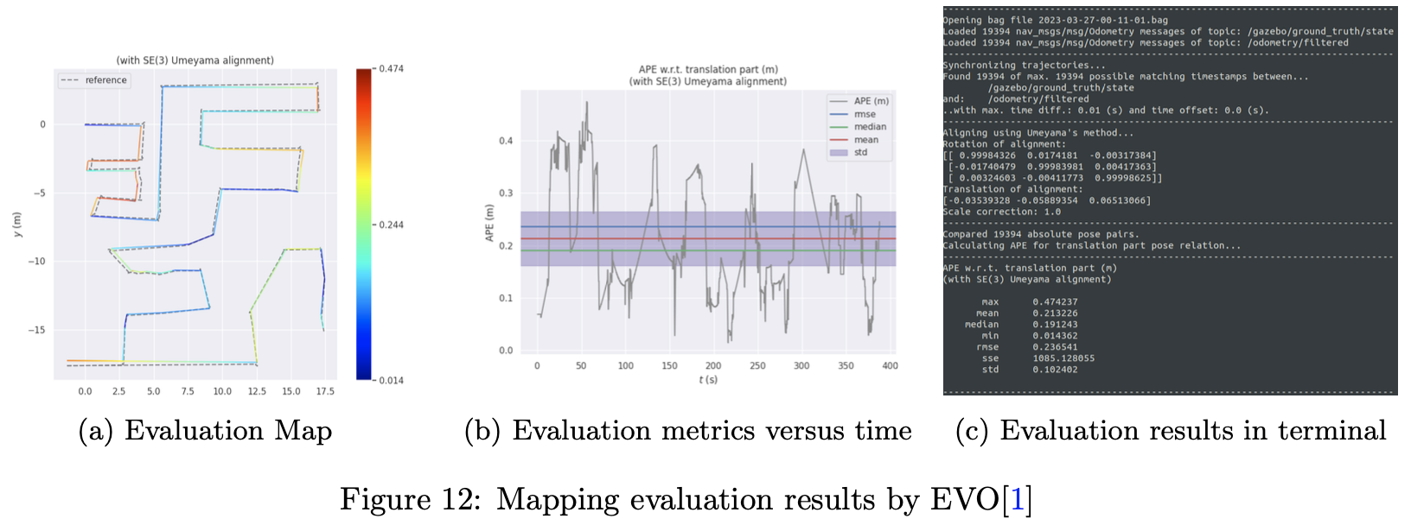
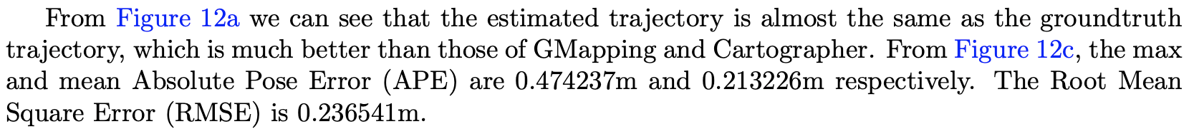
Task 1 Mapping: ALOAM: Evalution

Slide 14
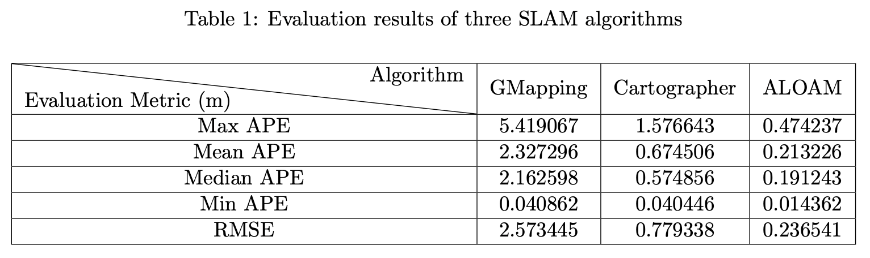
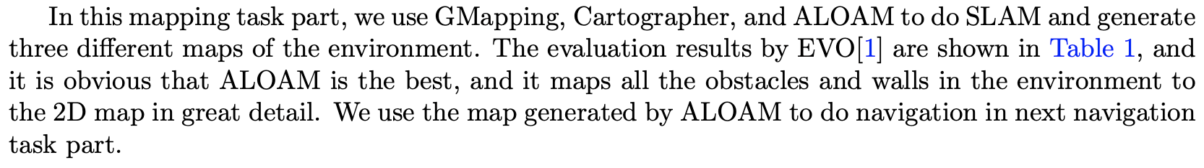
Task 1 Mapping: Summary

Slide 15
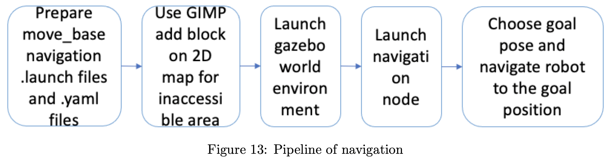
Task 2 Navigation: Pipeline

Slide 16
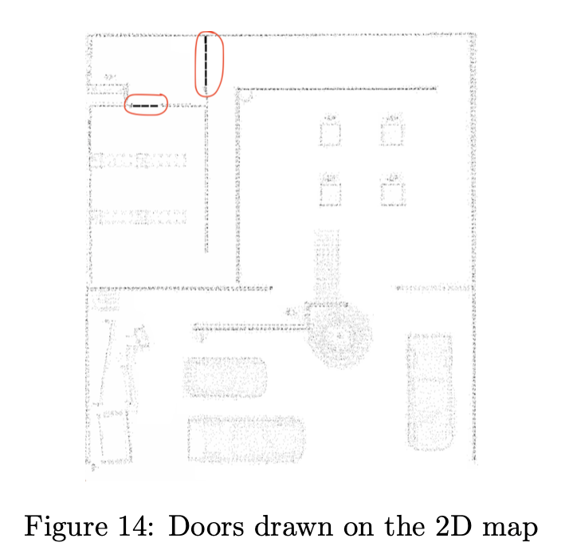
Task 2 Navigation: Pipeline

Slide 17
Task 2 Navigation: Move_base
The move_base package provides an implementation of an action that, given a goal in the world, will attempt to reach it with a mobile base. The move base node links together a global and local planner to accomplish its global navigation task. The move base node maintains two cost maps, one for the global planner, and one for a local planner that are used to accomplish navigation tasks. We tune the parameters of the move base package and prepare .launch and .yaml files to make the robot follow the planned global path strictly.
The detail of the tuned files can be found in the report

Slide 18
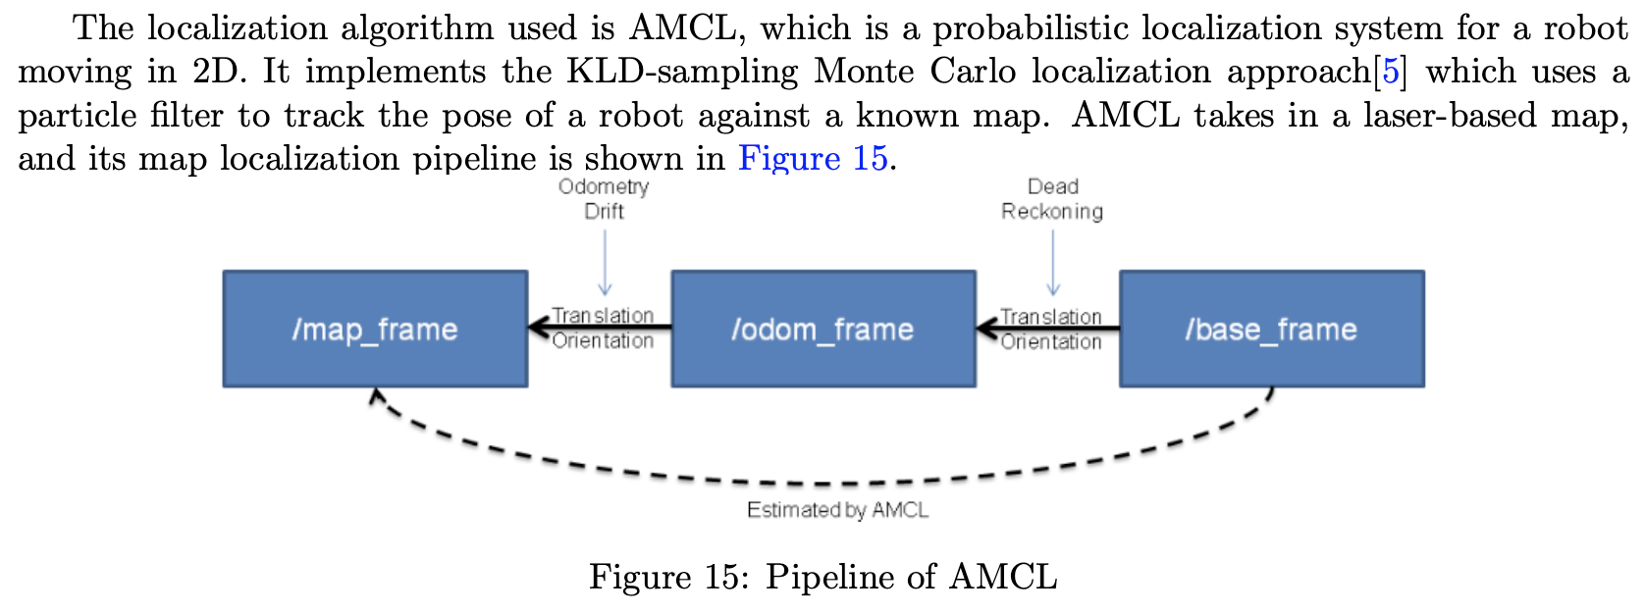
Task 2 Navigation: Localization

Slide 19
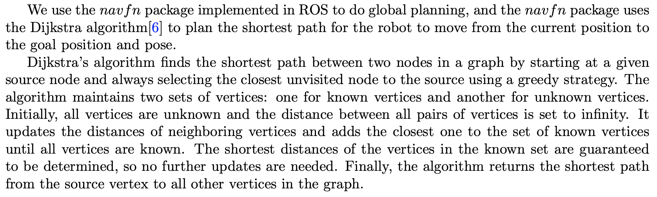
Task 2 Navigation: Planning: Global Planning: Dijkstra

Slide 20
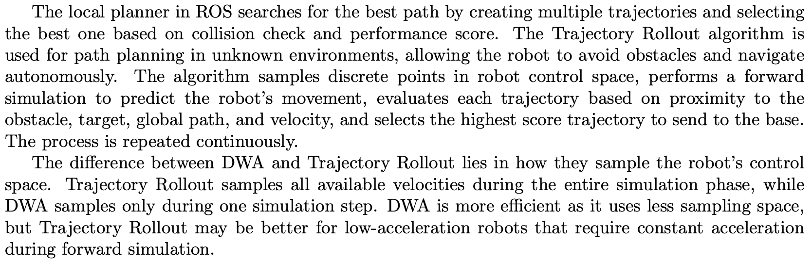
Task 2 Navigation: Planning: Local Planning: Trajectory Rollout

Slide 21
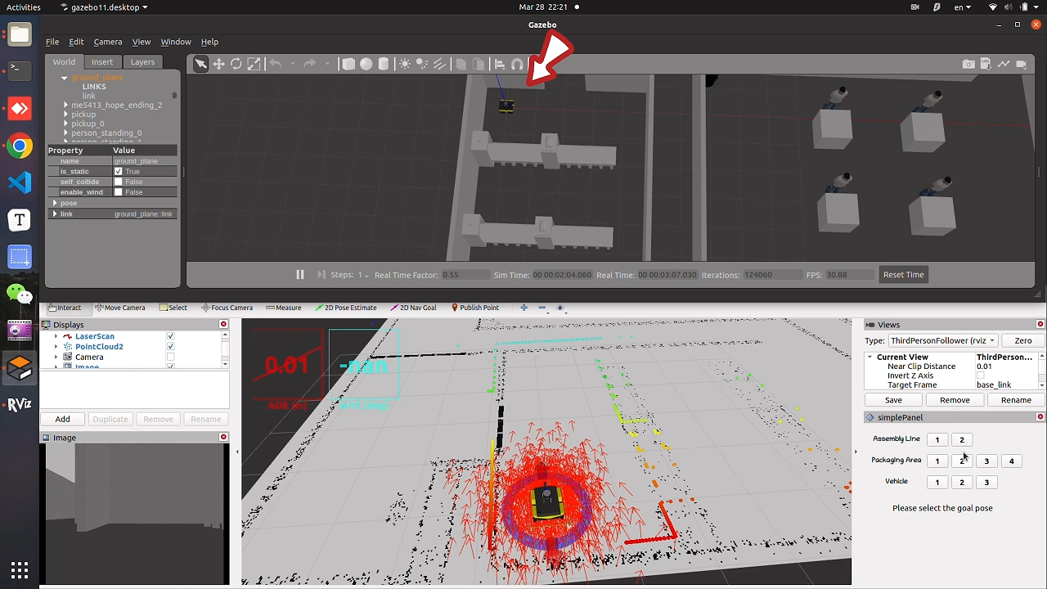
Task 2 Navigation: Result and Evaluation
We are Group 1, our navigation task is first to move to Assembly Line 2, then move to Package Area 2, and finally move to Vehicle 2.

Slide 22
Task 2 Navigation: Result and Evaluation

Slide 23
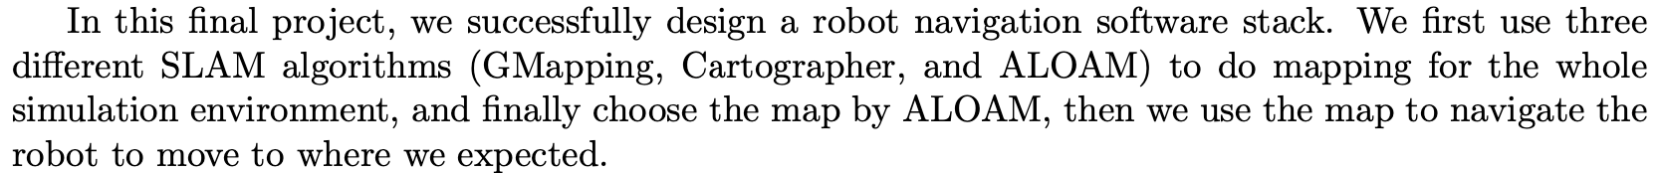
Summary
Code is available: https://github.com/JYS997760473/ME5413_Final_Project

